Slide 1
2ECOE76 MATLAB for Engineers Lecture 3
Prepared by
-Twinkle Bhavsar

Slide 2


Outline
Subarrays
Special Values
Displaying Output Data
Data Files
Scalar and Array Operations
(Please see 2.8 of Chapman Book)

Slide 3
Subarrays

Slide 4
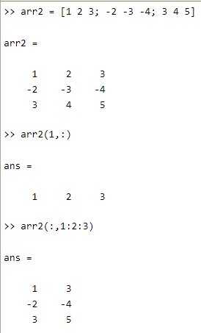
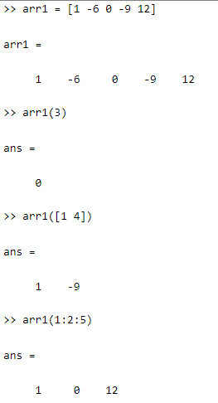


It is possible to select and use subsets of MATLAB arrays as though they were separate arrays.

Slide 5
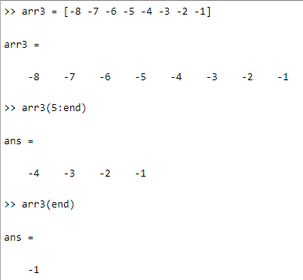
The end Function
MATLAB includes a special function named “end” that is very useful for creating array subscripts. When used in an array subscript, “end” returns the highest value
taken on by that subscript.

Slide 6
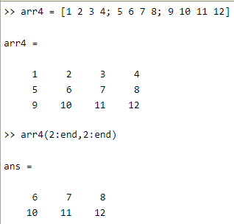
Note that the first end returned the value 3, while the second
end returned the value 4!

Slide 7
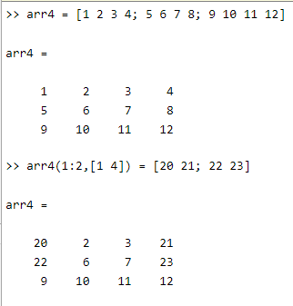
Using Subarrays on the Left-Hand Side of an Assignment Statement
It is also possible to use subarrays on the left-hand side of an assignment statement to update only some of the values in an array, as long as the shape (the number of rows and columns) of the values being assigned matches the shape of the subarray. If the shapes do not match, then an error will occur.
The array elements (1,1), (1,4), (2,1), and (2,4) were updated.

Slide 8
arr5(1:2,1:2) = [3 4]
It is illegal because the two sides do not have the same shape.

Slide 9
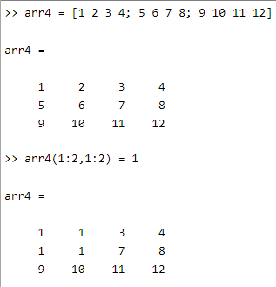
Assigning a Scalar to a Subarray
A scalar value on the right-hand side of an assignment statement always matches the shape specified on the left-hand side. The scalar value is copied into every element specified on the left-hand side of the statement.

Slide 10
Special Values

Slide 11
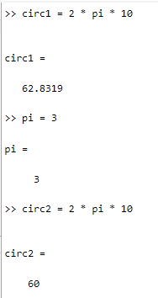
Special Values
MATLAB includes a number of predefined special values.
Used at any time in MATLAB without initializing them first.
Stored in ordinary variables, so they can be overwritten or modified by a user. If a new value is assigned to one of the predefined variables, then that new value will replace the default one in all later calculations.
Example: Calculate the circumference of a 10-cm circle with two different values of “pi”.

Slide 12
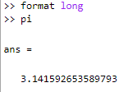


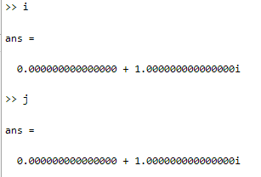


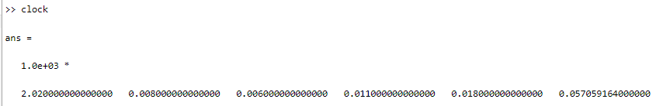
pi
Nan
eps
date
Inf
i,j
clock

Slide 13
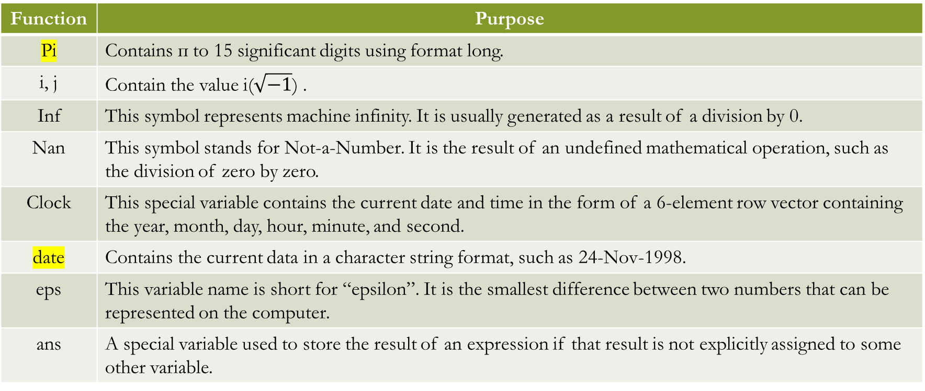
Predefined special values
Function | Purpose
Pi | Contains п to 15 significant digits using format long.
i, j | Contain the value i($\sqrt{−1}$) .
Inf | This symbol represents machine infinity. It is usually generated as a result of a division by 0.
Nan | This symbol stands for Not-a-Number. It is the result of an undefined mathematical operation, such as the division of zero by zero.
Clock | This special variable contains the current date and time in the form of a 6-element row vector containing the year, month, day, hour, minute, and second.
date | Contains the current data in a character string format, such as 24-Nov-1998.
eps | This variable name is short for “epsilon”. It is the smallest difference between two numbers that can be represented on the computer.
ans | A special variable used to store the result of an expression if that result is not explicitly assigned to some other variable.

Slide 14
Displaying Output Data

Slide 15


Displaying Output Data
Leave the semicolon off at the end of a statement and it will be echoed to the Command Window.
When data is echoed in the Command Window, integer values are always displayed as integers, character values are displayed as strings, and other values are printed using a default format.

Slide 16
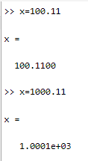
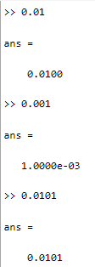
The default format for MATLAB shows four digits after the decimal point, and it may be displayed in scientific notation with an exponent if the number is too large(more than 3 digits before decimal point) or too small(more than 1 zeros after decimal point with 0 before decimal point ).

Slide 17
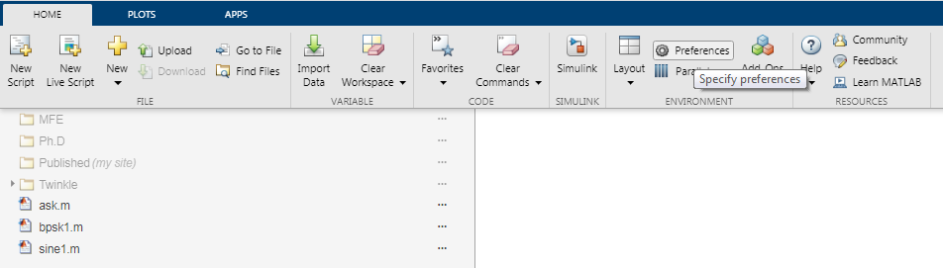
This default format can be changed in one of two ways:
From the main MATLAB Window menu.
Select the “File / Preferences” menu option. This option will pop up the preferences window as below:

Slide 18
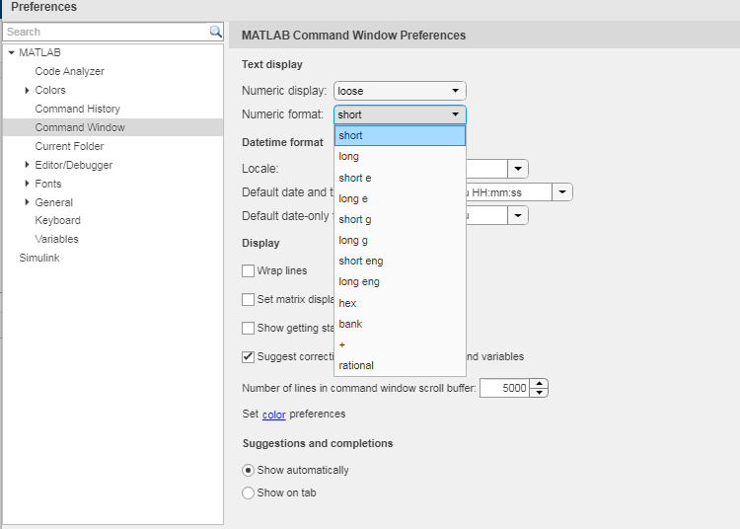
The format can be selected from the Command Window item in the preferences list.

Slide 19
2) A user can use the format command to change the preferences.
Format | Command | Results | Example
format | short | 4 digits after decimal (default format) Scaled fixed point format with 5 digits | 12.3457
format | long | 14 digits after decimal | 12.34567890123457
format | short e | 5 digits plus exponent | 1.2346e+001
format | short g | 5 total digits with or without exponent | 12.346
format | long e | 15 digits plus exponent | 1.234567890123457e+001
format | long g | 15 total digits with or without exponent | 12.3456789012346
format | bank | “dollars and cents” format | 12.35
format | hex | hexadecimal display of bits | 4028b0fcd32f707a
format | rat | approximate ratio of small integers | 1000/81
format | compact | suppress extra line feeds
format | loose | restore extra line feeds
format | + | Only signs are printed. | +
The data value used for the example is 12.345678901234567 in all cases.

Slide 20
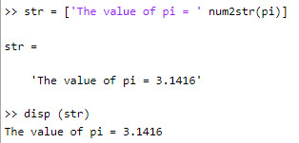
C. Another way to display data is with the “disp” function. The disp function accepts an array argument and displays the value of the array in the Command Window. If the array is of type char, then the character string contained in the array is printed out. This function is often combined with the functions num2str (convert a number to a string) and int2str (convert an integer to a string) to create messages to be displayed in the Command Window.

Slide 21
D. An even more flexible way to display data is with the “fprintf” function.
The general form of this function when it is used to print to the Command Window is
fprintf(format,data)
where format is a string describing the way the data is to be printed, and data is one or more scalars or arrays to be printed. The format is a character string containing text to be printed plus special characters describing the format of the data.

Slide 22


The characters %f are called conversion characters; they indicate that a value in the data list should be printed out in floating-point format at that location in the format string.
The characters \n are escape characters; they indicate that a line feed should be issued so that the following text starts on a new line.

Slide 23
Common Special Characters in “fprintf” Format Strings
Format String | Results
%d | Display value as an integer.
%e | Display value in exponential format.
%f | Display value in floating-point format.
%g | Display value in either floating-point or exponential format, whichever is shorter.
\n | Skip to a new line.

Slide 24

It is also possible to specify the width of the field in which a number will be displayed and the number of decimal places to display. This is done by specifying the width and precision after the % sign and before the f.
The conversion characters %6.2f indicate that the first data item in the function should be printed out in floating-point format in a field six characters wide, including two digits after the decimal point.

Slide 25
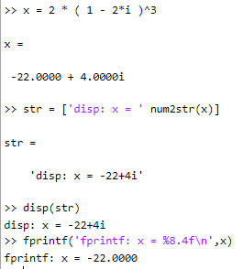
The “fprintf” function has one very significant limitation:
it displays only the real portion of a complex value.
This limitation can lead to misleading results when calculations produce complex answers. In those cases, it is better to use the disp function to display answers.
Example: The statements on the right side
calculate a complex value x and display it using
both “fprintf” and “disp”.
Note: The fprintf function ignored the imaginary part of
the answer.

Slide 26
Data Files

Slide 27
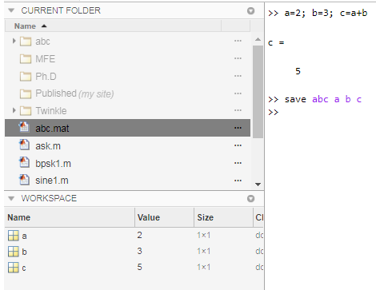
The save command saves data from the current MATLAB workspace into a disk file. The most common form of this command is
save filename var1 var2 var3
Where, filename is the name of the file where the variables are saved, and var1, var2, etc. are the variables to be saved in the file.

Slide 28

By default, the file name will be given the extension “mat,” and such data files are called MAT- files. If no variables are specified, then the entire contents of the workspace are saved.
A MAT-file created on any platform (PC, Mac, Unix, or Linux) can be read on any other platform, so MAT-files are a good way to exchange data between computers if both computers run MATLAB. Unfortunately, the MAT-file is in a format that cannot be read by other programs. If data must be shared with other programs, then the -ascii option should be specified, and the data values will be written to the file as ASCII character strings separated by spaces. However, the special information such as variable names and types are lost when the data is saved in ASCII format, and the resulting data file will be much larger.

Slide 29
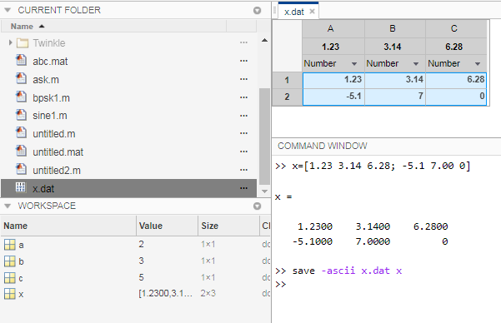
This data is in a format that can be read by spreadsheets or by programs written in other computer languages, so it makes it easy to share data between MATLAB programs and other applications.

Slide 30
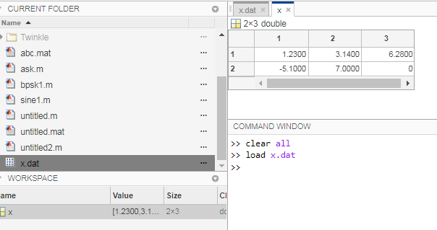
The load command loads data from a disk file into the current MATLAB workspace. The most common form of this command is
load filename
where, filename is the name of the file to be loaded.

Slide 31
If the file is a MAT-file, then all of the variables in the file will be restored, with the names and types the same as before. If a list of variables is included in the command, then only those variables will be restored.
If the given filename has no extent, or if the file extent is .mat, then the load command will treat the file as a MAT-file.
If the given filename has any file extension other than .mat, then the load command will treat the file as an ASCII file. The contents of an ASCII file will be converted into a MATLAB array having the same name as the file (without the file extension) that the data was loaded from.

